Slide 1

ECE 2700
Digital Circuits
Register Design
Cont’d
Copyright © 2010 Frank Vahid
Instructors of courses requiring Vahid's Digital Design textbook (published by John Wiley and Sons) have permission to modify and use these slides for customary course-related activities, subject to keeping this copyright notice in place and unmodified. These slides may be posted as unanimated pdf versions on publicly-accessible course websites.. PowerPoint source (or pdf with animations) may not be posted to publicly-accessible websites, but may be posted for students on internal protected sites or distributed directly to students by other electronic means. Instructors may make printouts of the slides available to students for a reasonable photocopying charge, without incurring royalties. Any other use requires explicit permission. Instructors may obtain PowerPoint source or obtain special use permissions from Wiley – see http://www.ddvahid.com for information.

Slide 2
Today’s Objectives
To become familiar with multifunction registers
To become proficient in describing a register in Verilog

Slide 3
Multifunction Register
Many registers have multiple functions
  Load, shift, clear (load all 0s)
  And retain present value, of course
    This functionality should always be there
Easily designed using muxes
  Just connect each mux input to achieve desired function

Slide 4
Multifunction Register Design
s1
s0
Operation
0
0
Maintain present value
0
1
Parallel load
1
0
Shift right
1
1
Shift left
I
3
I
2
I
1
I
0
shr_in
shl_in
s1
s0
3
2
1
0
3
2
1
0
3
2
1
0
3
2
1
0
shl_in
I
3
I
2
I
1
I
0
shr_in
D
D
D
D
s1
s0
Q
Q
Q
Q
Q3
Q2
Q1
Q0
Q3
Q2
Q1
Q0

Slide 5
Now You Try
s1
s0
Operation
0
0
Maintain present value
0
1
Clear
1
0
Complement current bit value
1
1
Load data
I
3
I
2
I
1
I
0
0
0
0
0
s1
s0
3
2
1
0
3
2
1
0
3
2
1
0
3
2
1
0
s1
I
3
I
2
I
1
I
0
s0
D
D
D
D
Q
Q
Q
Q
Q3
Q2
Q1
Q0
Q3
Q2
Q1
Q0
What if there are 5 operations?

Slide 6

Multifunction Reg with Separate Controls
ld
shr
shl
Operation
s1
s0
Operation
0
0
Maintain present value
0
0
0
Maintain present value
0
1
Parallel load
0
0
1
Shift left
1
0
Shift right
0
1
0
Shift right
1
1
Shift left
0
1
1
Shift right – shr has priority over shl
1
0
0
Parallel load
1
0
1
Parallel load – ld has priority
I
3
I
2
I
1
I
0
1
1
0
Parallel load – ld has priority
shr_in
1
1
1
Parallel load – ld has priority
ld
shr_in
I
3
I
2
I
1
I
0
?
s1
shl_in
shr
s0
shl_in
Operation Table
shl
Q3
Q2
Q1
Q0
ld
shr
shl
Ope
r
a
tion
s1
s0
Q3
Q2
Q1
Q0
0
0
0
M
ai
n
tain
v
alue
0
0
0
0
1
Shi
f
t le
f
t
1
1
0
1
X
Shift right
1
0
s1 = ld’* shr’* shl + ld’* shr
s0 = ld’* shr’* shl + ld
1
X
X
Parallel load
0
1

Slide 7
Register Design Process
Determine mux size
  Always include hold (maintain present value) function
Create operation table
Connect inputs
Map control line (if control inputs are separate)

Slide 8
Example
Desired operations
  Maintain present value, clear, complement present value, parallel load
  Want unique control input for each operation
Step 1
  Determine mux size
    4x1
s1
s0
3
2
1
0
3
2
1
0
3
2
1
0
3
2
1
0
D
D
D
D
Q
Q
Q
Q
Q3
Q2
Q1
Q0

Slide 9
Example
Desired operations
  Maintain present value, clear, complement present value, parallel load
  Want unique control input for each operation
Step 2
  Create operation table
s1
s0
Operation
0
0
Maintain present value
0
1
Clear
1
0
Complement current bit value
1
1
Load data

Slide 10
Example
Desired operations
  Maintain present value, clear, complement present value, parallel load
  Want unique control input for each operation
Step 3
  Connect mux inputs
I
3
I
2
I
1
I
0
0
0
0
0
s1
s0
Operation
0
0
Maintain present value
s1
s0
3
2
1
0
3
2
1
0
3
2
1
0
3
2
1
0
0
1
Clear
1
0
Complement current bit value
D
D
D
D
1
1
Load data
Q
Q
Q
Q
Q3
Q2
Q1
Q0

Slide 11
Example
Desired operations
  Maintain present value, clear, complement present value, parallel load
  Want unique control input for each operation
Step 4
  Map control lines
Inputs
Outputs
clr
ld
comp
s1
s0
Operation
0
0
0
0
0
Maintain present value
0
0
1
1
0
Complement current bit value
s1
s0
Operation
0
1
X
1
1
Load data
0
0
Maintain present value
1
X
X
0
1
Clear
0
1
Clear
1
0
Complement current bit value
1
1
Load data
s1 = clr’* ld’ * comp + clr’ * ld
s0 = clr’* ld + clr

Slide 12
Multifunction Register in Verilog
Two ways
  Structurally
    Flip-flops, muxes, etc…
  Behaviorally
I
3
I
2
I
1
I
0
Shr_in
Ld
Shr
Shl_in
Shl
Rst
Q3
Q2
Q1
Q0
Ld
Shr
Shl
Operation
0
0
0
M
ai
n
tain
v
alue
0
0
1
Shift left
0
1
X
Shift right
1
X
X
Parallel load
Compact register operation table,
clearly showing priorities

Slide 13
Behavioral Description
`timescale 1 ns/1 ns
module MfReg4(I, Q, Ld, Shr, Shl, Shr_in, Shl_in, Clk, Rst);
input [3:0] I;
output [3:0] Q;
input Ld, Shr, Shl, Shr_in, Shl_in;
input Clk, Rst;
reg [3:0] R;
always @(posedge Clk) begin
if (Rst == 1)
R <= 4'b0000;
else if (Ld == 1)
R <= I;
else if (Shr == 1) begin
R[3] <= Shr_in; R[2] <= R[3];
R[1] <= R[2]; R[0] <= R[1];
end
else if (Shl == 1) begin
R[0] <= Shl_in; R[1] <= R[0];
R[2] <= R[1]; R[3] <= R[2];
end
end
assign Q = R;
endmodule
Shift by assigning each bit
  Statement order doesn't matter
  Why?
Ld
Shr
Shl
Operation
0
0
0
M
ai
n
tain
v
alue
0
0
1
Shift left
0
1
X
Shift right
1
X
X
Parallel load

Slide 14
Behavioral Description
`timescale 1 ns/1 ns
module MfReg4(I, Q, Ld, Shr, Shl, Shr_in, Shl_in, Clk, Rst);
input [3:0] I;
output [3:0] Q;
input Ld, Shr, Shl, Shr_in, Shl_in;
input Clk, Rst;
reg [3:0] R;
always @(posedge Clk) begin
if (Rst == 1)
R <= 4'b0000;
else if (Ld == 1)
R <= I;
else if (Shr == 1) begin
R[3] <= Shr_in; R[2] <= R[3];
R[1] <= R[2]; R[0] <= R[1];
end
else if (Shl == 1) begin
R[0] <= Shl_in; R[1] <= R[0];
R[2] <= R[1]; R[3] <= R[2];
end
end
assign Q = R;
endmodule
Use R for storage
  Best not to read from output Q
Use continuous assignment to update Q when R changes
  assign is used outside of the always statement

Slide 15
Behavioral Description
`timescale 1 ns/1 ns
module MfReg4(I, Q, Ld, Shr, Shl, Shr_in, Shl_in, Clk, Rst);
input [3:0] I;
output [3:0] Q;
input Ld, Shr, Shl, Shr_in, Shl_in;
input Clk, Rst;
reg [3:0] R;
always @(posedge Clk) begin
if (Rst == 1)
R <= 4'b0000;
else if (Ld == 1)
R <= I;
else if (Shr == 1) begin
R[3] <= Shr_in; R[2] <= R[3];
R[1] <= R[2]; R[0] <= R[1];
end
else if (Shl == 1) begin
R[0] <= Shl_in; R[1] <= R[0];
R[2] <= R[1]; R[3] <= R[2];
end
end
assign Q = R;
endmodule
Identifier on left of "=" must be a net, not a variable

Slide 16
Behavioral Description
`timescale 1 ns/1 ns
module MfReg4(I, Q, Ld, Shr, Shl, Shr_in, Shl_in, Clk, Rst);
input [3:0] I;
output reg [3:0] Q;
input Ld, Shr, Shl, Shr_in, Shl_in;
input Clk, Rst;
reg [3:0] R;
always @(posedge Clk) begin
if (Rst == 1)
R <= 4'b0000;
else if (Ld == 1)
R <= I;
else if (Shr == 1) begin
R[3] <= Shr_in; R[2] <= R[3];
R[1] <= R[2]; R[0] <= R[1];
end
else if (Shl == 1) begin
R[0] <= Shl_in; R[1] <= R[0];
R[2] <= R[1]; R[3] <= R[2];
end
Q <= R;
end
endmodule
This is incorrect
  Q gets the present value of R, not the scheduled value
    Q will lag behind R by 1 cycle

Slide 17

Behavioral Description
`timescale 1 ns/1 ns
module MfReg4(I, Q, Ld, Shr, Shl, Shr_in, Shl_in, Clk, Rst);
input [3:0] I;
output [3:0] Q;
input Ld, Shr, Shl, Shr_in, Shl_in;
input Clk, Rst;
reg [3:0] R;
always @(posedge Clk) begin
if (Rst == 1)
R <= 4'b0000;
else if (Ld == 1)
R <= I;
else if (Shr == 1) begin
R[3] <= Shr_in; R[2] <= R[3];
R[1] <= R[2]; R[0] <= R[1];
end
else if (Shl == 1) begin
R[0] <= Shl_in; R[1] <= R[0];
R[2] <= R[1]; R[3] <= R[2];
end
end
assign Q = R;
endmodule
What if we have a register that is 64 bit-wide?

Slide 18
Loops To The Rescue! (1)
`timescale 1 ns/1 ns
module MfReg64(I, Q, Ld, Shr, Shl, Shr_in, Shl_in, Clk, Rst);
input [63:0] I;
output [63:0] Q;
input Ld, Shr, Shl, Shr_in, Shl_in;
input Clk, Rst;
reg [63:0] R;
integer Index;
always @(posedge Clk) begin
if (Rst == 1)
R <= 4'b0000;
else if (Ld == 1)
R <= I;
else if (Shr == 1) begin
R[31] <= Shr_in;
for (Index=0; Index<=30; Index=Index+1) begin
R[Index] <= R[Index+1];
end
else if (Shl == 1) begin
…
end
end
assign Q = R;
endmodule
Can also use “reg Index;” but this makes the code clearer

Slide 19
Loops To The Rescue! (2)
...
// Vector Procedure
initial begin
Rst_s <= 1;
Shr_s <= 0; Shr_in_s <= 0;
@(posedge Clk_s);
#5 Rst_s <= 0;
@(posedge Clk_s);
#5 Shr_s <= 1; Shr_in_s <= 1;
for (Index=0; Index<=15; Index=Index+1) begin
@(posedge Clk_s);
end
#5;
if (Q_s != 32'hFFFF0000)
$display("Failed Q=FFFF0000");
Shr_s <= 1; Shr_in_s <= 0;
for (Index=0; Index<=15; Index=Index+1) begin
@(posedge Clk_s);
end
#5;
if (Q_s != 32'h0000FFFF)
$display("Failed Q=0000FFFF");
Shr_s <= 0;
end
endmodule
Can use loop in testbench as well

Slide 20
Today’s Objectives
To become familiar with multifunction registers
To become proficient in describing a register in Verilog

Slide 21
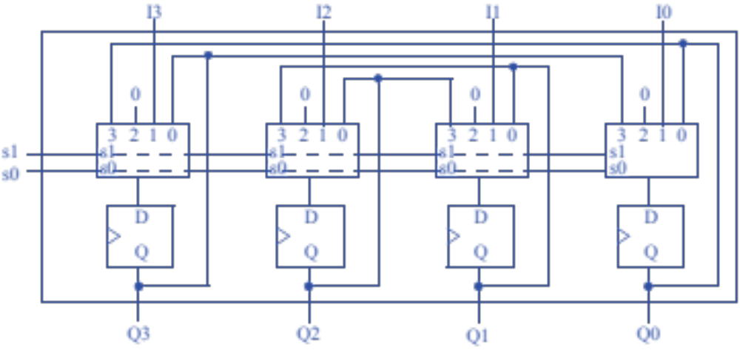
Question
What are the functions supported by the following register?

